Slide 1

BLOOD BANK MANAGMENT SYSTEM
Mayur Parab :- 21104131
Ankul Yadav :- 21104052
Shubham Yadav :- 21104091
Sujal Sharma :- 21104128
Project Guide
Ms. Mansi Choche

Slide 2
Contents
●
Introduction
●
Objectives
●
Scope
●
Features / Functionality
●
Project Outcomes
●
Technology Stack
●
Block Diagram

Slide 3
1. Introduction
A blood bank is a place where blood bag that is collected from blood donation events is stored in one place.
The population of the world is increasing rapidly each year and so are diseases and health issues. With an increase in population, there is a simultaneous increase in the demand for blood for various medical reasons.
Even though the global population is so enormous, the number of blood donors is very less, and this makes it difficult to find the required blood donor for the required blood group.
This project aims at maintaining all the information pertaining to blood donors, different blood groups available in blood bank and help them manage in a better way.

Slide 4
2. Objectives
To help people in emergency.
To bridge the gap between blood banks, donors, and needy people through this system.
To support local communities and hospitals.
To provide a dynamic database that is storing donors Information and can communicate with them easily.

Slide 5
3. Scope
Can be useful to manage blood demand and supply within the blood supply chain.
Can improve the efficiency of data communication within the supply chain to reduce response time for each blood demand request.
Can be applied to find the information about donor easily.

Slide 6
4. Feature /Functionality
Provides search facilities based on various factors. Such as Blood, Blood Group, Blood Bank, Stock
Manage the information of Donor such as updating and deleting Donor’s information.
Shows the information of the Blood Group and available Stocks.
Integration of all records of Stocks.

Slide 7
5. Outcome Of Project
It helps in keeping track of blood units in stock.
It saves time as the admin can search donors without any inconvenience.
It helps in automating many process involved in blood bank which can reduce error and save time.
This is 24x7 service so admin can get information of blood donor any time.

Slide 8
6. Technology Stack
Python
HTML
CSS
JavaScript
Django Framework
MySQL

Slide 9
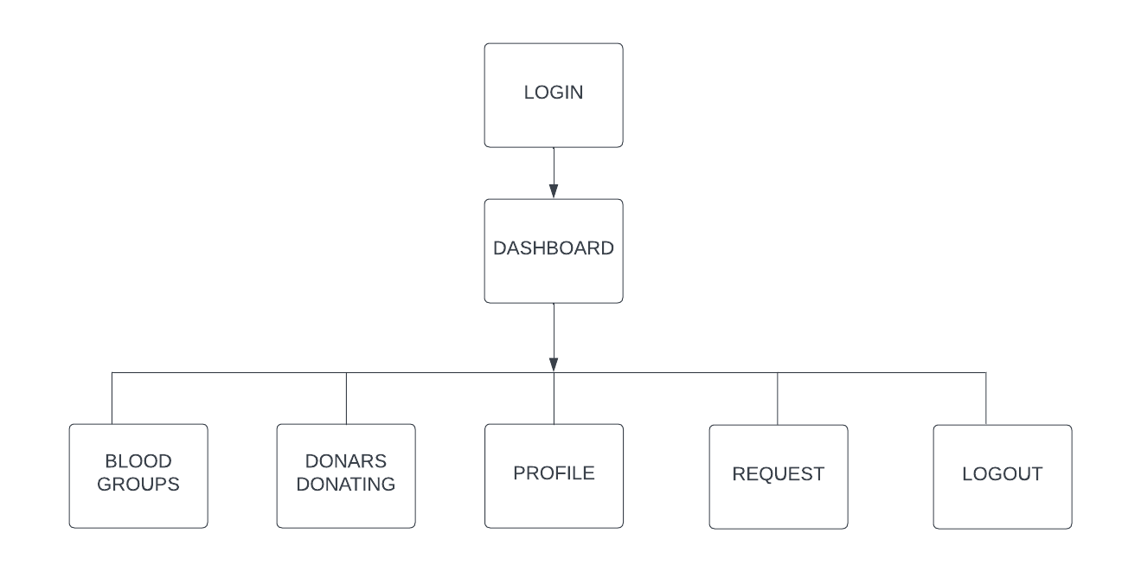
7. Block Diagram

